Slide 1
React Components
Dr. Adeel Ansari

Slide 2
Components
So far, we've created one component - the App component. Almost everything in React consists of components, which can be class components or simple components.
Most React apps have many small components, and everything loads into the main App component. Components also often get their own file, so let's change up our project to do so.

Slide 3
Components
Remove the App class from index.js, so it looks like this.
Index.js
import React from 'react';
import ReactDOM from 'react-dom';
import './index.css';
import App from './App';
ReactDOM.render(<App />, document.getElementById('root'));

Slide 4
Components
We'll create a new file called App.js and put the component in there.
import React, {Component} from 'react'
class App extends Component {
render() {
return (
<div className="App">
<h1>Hello, React!</h1>
</div>
)
}
}
export default App
We export the component as App and load it in index.js. It's not mandatory to separate components into files, but an application will start to get unwieldy and out-of-hand if you don't.

Slide 5
Class Components
Table.js
import React, {Component} from 'react'
class Table extends Component {
render() {
return (
<table>
<thead>
<tr>
<th>Name</th>
<th>Job</th>
</tr>
</thead>
<tbody>
<tr>
<td>Charlie</td>
<td>Janitor</td>
</tr>
<tr>
<td>Mac</td>
<td>Bouncer</td>
</tr>
<tr>
<td>Dee</td>
<td>Aspiring actress</td>
</tr>
<tr>
<td>Dennis</td>
<td>Bartender</td>
</tr>
</tbody>
</table>
)
}
}
export default Table
Let's create another component. We're going to create a table. Make Table.js, and fill it with the following data.
This component we created is a custom class component.
We capitalize custom components to differentiate them from regular HTML elements.
Back in App.js, we can load in the Table, first by importing it in:
import Table from './Table'

Slide 6
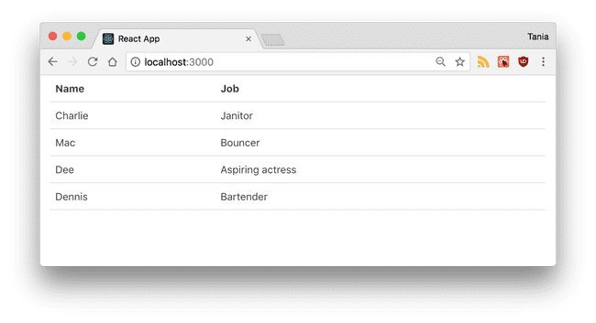
Class Components
Then by loading it into the render() of App, where before we had "Hello, React!". I also changed the class of the outer container.
App.js
import React, {Component} from 'react'
import Table from './Table'
class App extends Component {
render() {
return (
<div className="container">
<Table />
</div>
)
}
}
export default App
If you check back on your live environment, you'll see the Table loaded in.

Slide 7
Class Components
Now we've seen what a custom class component is. We could reuse this component over and over. However, since the data is hard-coded into it, it wouldn't be too useful at the moment.

Slide 8
Simple Components
The other type of component in React is the simple component, which is a function. This component doesn't use the class keyword. Let's take our Table and make two simple components for it - a table header, and a table body.
We're going to use ES6 arrow functions to create these simple components. First, the table header.

Slide 9
Table1.js
import React, {Component} from 'react'
const TableHeader = () => {
return (
<thead>
<tr>
<th>Name</th>
<th>Job</th>
</tr>
</thead>
)
}
const TableBody = () => {
return (
<tbody>
<tr>
<td>Charlie</td>
<td>Janitor</td>
</tr>
<tr>
<td>Mac</td>
<td>Bouncer</td>
</tr>
<tr>
<td>Dee</td>
<td>Aspiring actress</td>
</tr>
<tr>
<td>Dennis</td>
<td>Bartender</td>
</tr>
</tbody>
)
}
Then the body. →
Now our Table1 file will look like this. Note that the TableHeader and TableBody components are all in the same file, and being used by the Table class component. (Goto Next Slide)

Slide 10
Table1.js
App.js
import React, {Component} from 'react'
const TableHeader = () => {…
}
const TableBody = () => {…
}
class Table1 extends Component {
render() {
return (
<table>
<TableHeader />
<TableBody />
</table>
)
}
}
export default Table1
import React, {Component} from 'react'
import Table1 from './Table1'
class App extends Component {
render() {
return (
<div className="container">
<Table1 />
</div>
)
}
}
export default App
Everything should appear as it did before. As you can see, components can be nested in other components, and simple and class components can be mixed.

Slide 11
Components
A class component must include render(), and the return can only return one parent element.
As a wrap up, let's compare a simple component with a class component.
simple component
class component
const SimpleComponent = () => {
return <div>Example</div>
}
class ClassComponent extends Component {
render() {
return <div>Example</div>
}
}
Note that if the return is contained to one line, it does not need parentheses.

